Slide 1
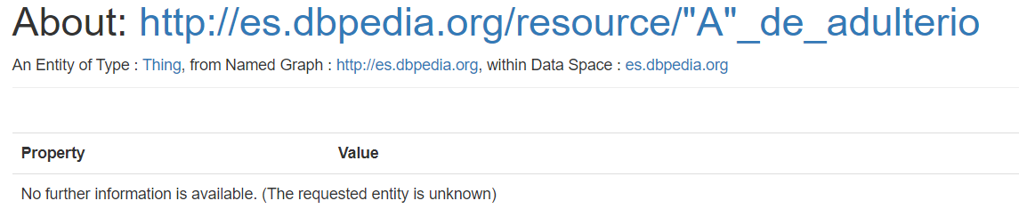
DBPEDIA SPOTLIGHT DASHBOARD
First steps:
Get model raw data (for Spanish and English)
DBpedia datasets (instance-types, redirects, disambiguations)
Wikipedia statistics (uriCounts, pairCounts, sfAndTotalCounts, tokenCounts)
Validate Dbpedia links (entities)
Visualize valid types and invalid types according to DBpedia hierarchy
Impact of invalid links

Slide 2



DBPEDIA SPOTLIGHT DASHBOARD
First ideas:
Script for downloading raw data -> get_resources.sh
Download DBpedia datasets
Download Wikipedia statistics
Use rdfpandas Python library to convert instance_types.nt file into Python dataframe
Faster to extract and count types using Unix commands and then convert into dataframe for visualization
Transform instance_types data into types.tsv file -> get_resources.sh
Convert wikipedia statistics and instance_types data into Python dataframe -> resources.py
Make requests to each DBpedia entity in instance_types.nt file to check if entities are valid or not
valid_types.tsv –> visualize valid types
invalid_types.tsv -> visualize invalid types

Slide 3
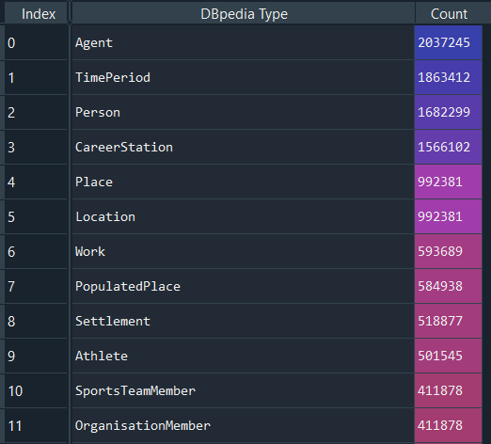
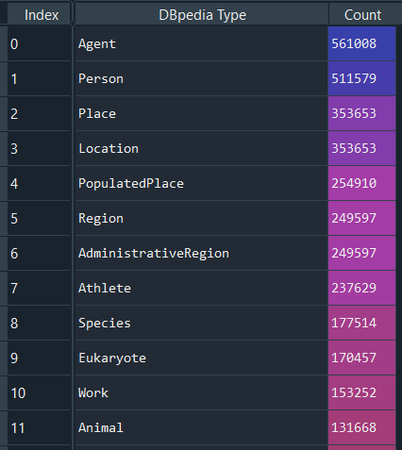
PROBLEMS
Types visualization:
Some hierarchy types are missing in the instance_types file
470 types for English
187 types for Spanish

Slide 4
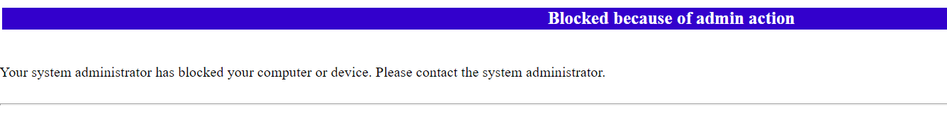
PROBLEMS
Dbpedia entities validation:
Spanish DBpedia blocked my IP address for 1 day due to excessive requests
Processes that made requests in the background (get_resources.sh and check_url_file.sh)
Forgot to put timeout between each request

Slide 5
New idea for Entity validation
Do SPARQL query to get ALL distinct entities for each language (English and Spanish) and store results in dbpedia_resources.txt file -> query.py
Look for instance_types urls in dbpedia_resources.txt file -> get_resources.sh
Valid urls will be in that file -> valid_types.tsv file
Otherwise they will be invalid urls -> invalid_urls.txt and invalid_types.tsv file
Once we have invalid_urls.txt file, get invalid links impact using uriCounts dataframe -> validate.py

